Slide 1
Requirements Engineering Processes
requirement engineering process – feasibility studies – requirements – elicitation – validation and management

Slide 2
Requirements engineering processes
The processes used for RE vary widely depending on the application domain, the people involved and the organisation developing the requirements.
However, there are a number of generic activities common to all processes
Requirements elicitation;
Requirements analysis;
Requirements validation;
Requirements management.

Slide 3
The requirements engineering process
F
easibility
R
equir
ements
stud
y
elicitation and
anal
ysis
R
equir
ements
specification
F
easibility
R
equir
ements
r
epor
t
validation
S
ystem
models
User and system
requirements
R
equir
ements
document

Slide 4
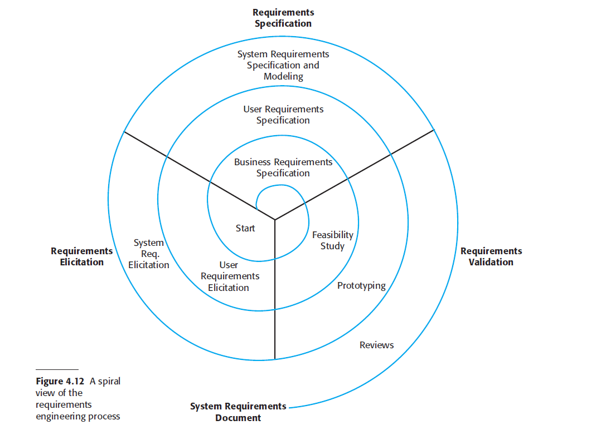
Requirements engineering
Notes:
It presents an alternative perspective on the requirements engineering process in Fig.2.7. This presents the process as a three-stage activity where the activities are organized as an iterative process around a spiral.
This spiral model accommodates approaches to development in which the requirements are developed to different levels of detail. The number of iterations
around the spiral can vary, so the spiral can be excited after some or all of the user requirements have been elicited. If the prototyping activity shown under requirements validation is extended to include iterative development.

Slide 5
Feasibility studies
A feasibility study decides whether or not the proposed system is worthwhile.
A short focused study that checks
If the system contributes to organisational objectives;
If the system can be engineered using current technology and within budget;
If the system can be integrated with other systems that are used.

Slide 6
Feasibility study implementation
Based on information assessment (what is required), information collection and report writing.
Questions for people in the organisation
What if the system wasn’t implemented?
What are current process problems?
How will the proposed system help?
What will be the integration problems?
Is new technology needed? What skills?
What facilities must be supported by the proposed system?

Slide 7
Elicitation and analysis
Sometimes called requirements elicitation or requirements discovery.
Involves technical staff working with customers to find out about the application domain, the services that the system should provide and the system’s operational constraints.
May involve end-users, managers, engineers involved in maintenance, domain experts, trade unions, etc. These are called stakeholders.

Slide 8
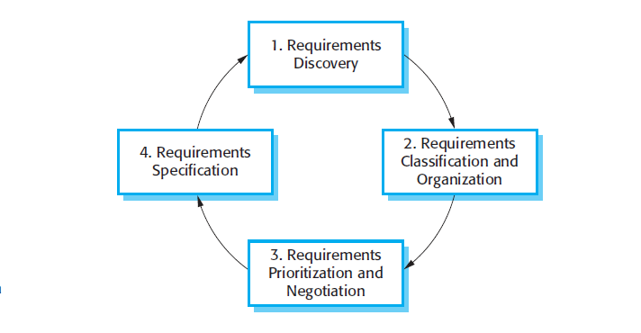
The requirements elicitation and analysis process

Slide 9
Process activities
A very general process model of the elicitation and analysis process is shown in Fig
Requirements discovery
Interacting with stakeholders to discover their requirements. Domain requirements are also discovered at this stage.
Requirements classification and organisation
Groups related requirements and organises them into coherent clusters.
Prioritisation and negotiation
Prioritising requirements and resolving requirements conflicts.
Requirements documentation
Requirements are documented and input into the next round of the spiral.

Slide 10
Problems of requirements analysis
Stakeholders don’t know what they really want.
Stakeholders express requirements in their own terms.
Different stakeholders may have conflicting requirements.
Organisational and political factors may influence the system requirements.
The requirements change during the analysis process. New stakeholders may emerge and the business environment change.

Slide 11
Requirements discovery
The process of gathering information about the proposed and existing systems and distilling the user and system requirements from this information.
Sources of information include documentation, system stakeholders and the specifications of similar systems.

Slide 12
ATM stakeholders
Bank customers – who receive services
Representatives of other banks – who have reciprocal agreements for ATM usage
Bank branch managers –who obtain management information
Counter staff – who involved in day-to-day running of system
Database administrators - who responsible for integrating system with customers database
Bank Security managers
The Bank’s Marketing department
Hardware and software maintenance engineers
Banking regulators Who ensures system conforms to banking regulations

Slide 13
Viewpoints
Viewpoints are a way of structuring the requirements to represent the perspectives of different stakeholders. Stakeholders may be classified under different viewpoints.
This multi-perspective analysis is important as there is no single correct way to analyse system requirements.

Slide 14
Types of viewpoint
Interactor viewpoints
People or other systems that interact directly with the system. In an ATM, the customer’s and the account database are interactor VPs.
Indirect viewpoints
Stakeholders who do not use the system themselves but who influence the requirements. In an ATM, management and security staff are indirect viewpoints.
Domain viewpoints
Domain characteristics and constraints that influence the requirements. In an ATM, an example would be standards for inter-bank communications.

Slide 15
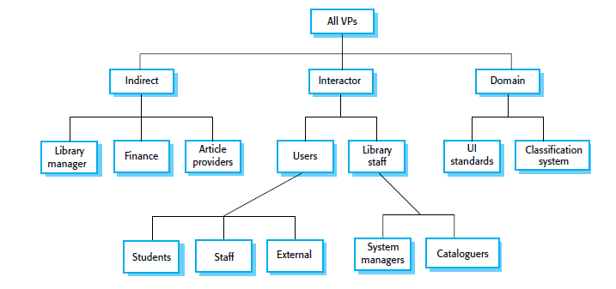
LIBSYS viewpoint hierarchy

Slide 16
Interviewing As a practice in Requirements collection
In formal or informal interviewing, the RE team puts questions to stakeholders about the system that they use and the system to be developed.
There are two types of interview
Closed interviews where a pre-defined set of questions are answered.
Open interviews where there is no pre-defined agenda and a range of issues are explored with stakeholders.

Slide 17
Interviews in practice
Normally a mix of closed and open-ended interviewing.
Interviews are good for getting an overall understanding of what stakeholders do and how they might interact with the system.
Interviews are not good for understanding domain requirements
Requirements engineers cannot understand specific domain terminology;
Some domain knowledge is so familiar that people find it hard to articulate or think that it isn’t worth articulating.

Slide 18
Effective interviewers
Interviewers should be open-minded, willing to listen to stakeholders and should not have pre-conceived ideas about the requirements.
They should prompt the interviewee with a question or a proposal and should not simply expect them to respond to a question such as ‘what do you want’.

Slide 19
Scenarios(As part of Specifications)
Scenarios are real-life examples of how a system can be used.
They should include
A description of the starting situation;
A description of the normal flow of events;
A description of what can go wrong;
Information about other concurrent activities;
A description of the state when the scenario finishes.

Slide 20
LIBSYS scenario (1)

Slide 21
LIBSYS scenario (2)

Slide 22
Use cases
Use-cases are a scenario based technique in the UML which identify the actors in an interaction and which describe the interaction itself.
A set of use cases should describe all possible interactions with the system.
Sequence diagrams may be used to add detail to use-cases by showing the sequence of event processing in the system.

Slide 23
Article printing use-case

Slide 24
LIBSYS use cases

Slide 25
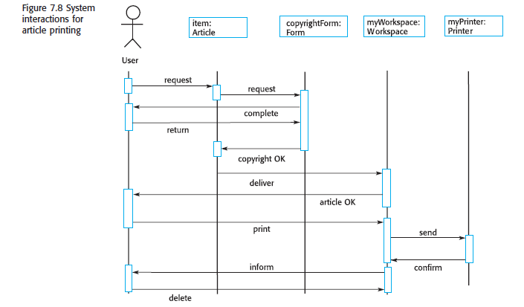
Article printing

Slide 26
Requirements validation
Concerned with demonstrating that the requirements define the system that the customer really wants.
Requirements error costs are high so validation is very important
Fixing a requirements error after delivery may cost up to 100 times the cost of fixing an implementation error.

Slide 27
Requirements checking- Characteristics
Validity. Does the system provide the functions which best support the customer’s needs?
Consistency. Are there any requirements conflicts?
Completeness. Are all functions required by the customer included?
Realism. Can the requirements be implemented given available budget and technology
Verifiability. Can the requirements be checked?

Slide 28
Requirements validation techniques
Requirements reviews
Systematic manual analysis of the requirements.
Prototyping
Using an executable model of the system to check requirements.
Test-case generation
Developing tests for requirements to check testability.

Slide 29
Requirements reviews
Regular reviews should be held while the requirements definition is being formulated.
Both client and contractor staff should be involved in reviews.
Reviews may be formal (with completed documents) or informal. Good communications between developers, customers and users can resolve problems at an early stage.
Review checks:
Verifiability. Is the requirement realistically testable?
Comprehensibility. Is the requirement properly understood?
Traceability. Is the origin of the requirement clearly stated?
Adaptability. Can the requirement be changed without a large impact on other requirements?

Slide 30
Requirements management
Requirements management is the process of managing changing requirements during the requirements engineering process and system development.
Requirements are inevitably incomplete and inconsistent
New requirements emerge during the process as business needs change and a better understanding of the system is developed;
Different viewpoints have different requirements and these are often contradictory.

Slide 31
Requirements change
The priority of requirements from different viewpoints changes during the development process.
System customers may specify requirements from a business perspective that conflict with end-user requirements.
The business and technical environment of the system changes during its development.

Slide 32
Requirements evolution
Initial
Changed
understanding
understanding
Of
pr
ob
lem
of
pr
o b
lem
Initial
Changed
r
equir
ements
r
equir
ements
T
ime

Slide 33
Enduring and volatile requirements
Enduring requirements. Stable requirements derived from the core activity of the customer organisation. E.g. a hospital will always have doctors, nurses, etc. May be derived from domain models
Volatile requirements. Requirements which change during development or when the system is in use. In a hospital, requirements derived from health-care policy

Slide 34
Requirements classification

Slide 35
Requirements management planning
During the requirements engineering process, you have to plan:
Requirements identification
How requirements are individually identified;
A change management process
The process followed when analysing a requirements change;
Traceability policies
The amount of information about requirements relationships that is maintained;
CASE tool support
The tool support required to help manage requirements change;

Slide 36
Traceability
Traceability is concerned with the relationships between requirements, their sources and the system design
Source traceability
Links from requirements to stakeholders who proposed these requirements;
Requirements traceability
Links between dependent requirements;
Design traceability
Links from the requirements to the design;

Slide 37
A traceability matrix
D-dependence
R-Relationship
Notes:
Figure shows a simple traceability matrix that records the dependencies between requirements. A ‘D’ in the row/column intersection illustrates that the requirement in the row depends on the requirement named in the column; an ‘R’ means that there is some other, weaker relationship between the requirements. For example, they may both define the requirements for parts of the same subsystem.

Slide 38
CASE tool support
Requirements storage
Requirements should be managed in a secure, managed data store.
Change management
The process of change management is a workflow process whose stages can be defined and information flow between these stages partially automated.
Traceability management
Automated retrieval of the links between requirements.

Slide 39
Requirements change management
Should apply to all proposed changes to the requirements.
Principal stages
Problem analysis. Discuss requirements problem and propose change;
Change analysis and costing. Assess effects of change on other requirements;
Change implementation. Modify requirements document and other documents to reflect change.

Slide 40
Change management

